Slide 1
Types of Erosion
and other conservation buzzwords

Slide 2
Gully Erosion
Loss of soil in large, often impassible trenches or ditches resulting from runoff
Channels are deeper than 30 cm and cannot be removed by normal cultivation
www.extension.iastate.edu

Slide 3
Rill Erosion
Loss of soil in small but visible tracks that are less than 20 cm deep
Can be removed by normal cultivation
Develop when surface water concentrates in depressions or low points
www.extension.iastate.edu

Slide 4
Sheet Erosion
Gradual removal of soil in thin layers by raindrop impact and shallow surface flow
Results in loss of the finest soil particles
www.extension.iastate.edu

Slide 5
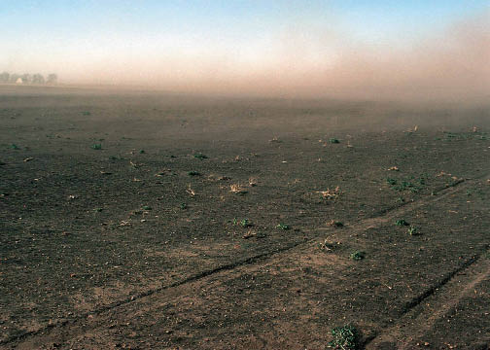
Wind Erosion
Soil loss resulting from the action of the wind
www.extension.iastate.edu

Slide 6
Conservation Practices
Operational
Structural
A short-run conservation practice that can be implemented on a year-by-year basis
A long-run practice that will be in place until removed or altered once it is implemented

Slide 7
Conservation
Definition
Things we conserve
The practice of protecting natural resources against harm and waste
Soil
Water
Air quality
Energy
Natural habitats

Slide 8
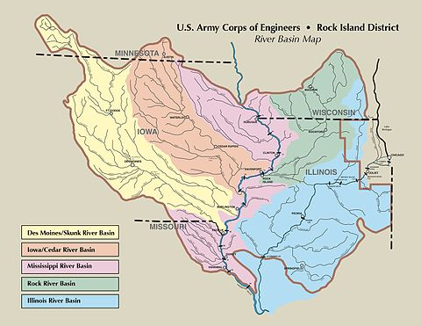
Watershed
The area of land that water flows across or underground on its way to the same stream or river

Slide 9
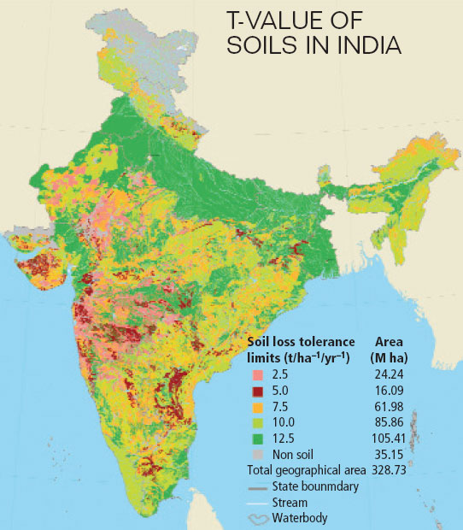
T Value
Maximum amount of soil loss in tons per acre per year that can be tolerated and still permit a high level of crop productivity to be sustained economically and indefinitely
Also called “Tolerable Soil Loss”

